Slide 1


Slide 2
Advancing Prediction of Stimulant Medication Misuse Through Graph Representation Learning
Hamid Razavi
(Part-time) Master student
Department of Data Science, NJIT
Advisor: Dr. Mengjia Xu
Committee Members: Dr. Hai Phan, Dr. Lijing Wang, Dr. Mengnan Du
Dec 2nd, 2024

Slide 3
Overview of Main Contributions
Objective:
Predicting stimulant misuse using graph neural networks and diverse machine learning algorithms on the latest National Survey on Drug Use and Health (NSDUH) dataset (2022)
Methods:
Graph Convolutional Networks (GCNs)
Various machine learning algorithms (i.e., Logistic regression, random forest, MLP, SVM, KNN, Gaussian Naïve Bayes)
Key Findings:
GCN achieved the highest accuracy (96.1%)
Explainable results with highlighted important features.
Notes:
Compared the results of the graph-based model GCN vs 6 other ML models
Use data from the National Survey on Drug Use and Health (NSDUH)
It is the primary source of statistics on the use of alcohol, tobacco, prescription psychotherapeutic medicines (such as sedatives, painkillers, tranquilizers, and stimulants), and other substances (such as cocaine and marijuana) by individuals in that population who are 12 years of age or older
GCN outperformed other models

Slide 4
Outline
Background and Motivation
Methodology
Predicting stimulant misuse based on classic ML models
Predicting stimulant misuse based on advanced GCNs
Interpretability investigation by GNN Explainer
Experimental results and analysis
Conclusions
Acknowledgement
Notes:
Compared the results of the graph based model GCN vs 6 other ML models
Use data from the National Survey on Drug Use and Health (NSDUH)
It is the primary source of statistics on the use of alcohol, tobacco, prescription psychotherapeutic medicines (such as sedatives, painkillers, tranquilizers, and stimulants), and other substances (such as cocaine and marijuana) by individuals in that population who are 12 years of age or older
GCN outperformed other models

Slide 5
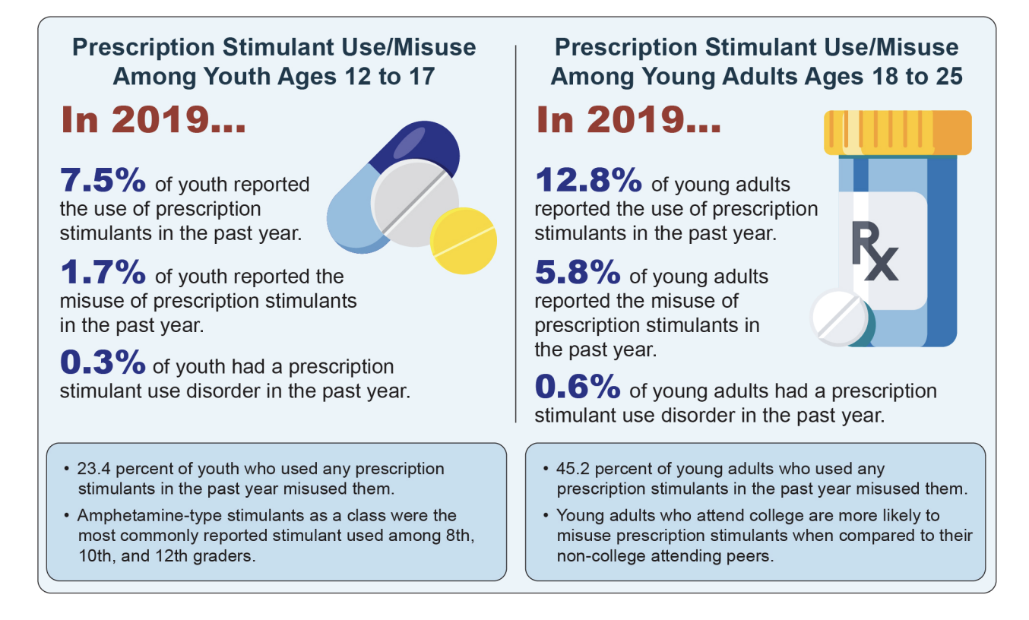
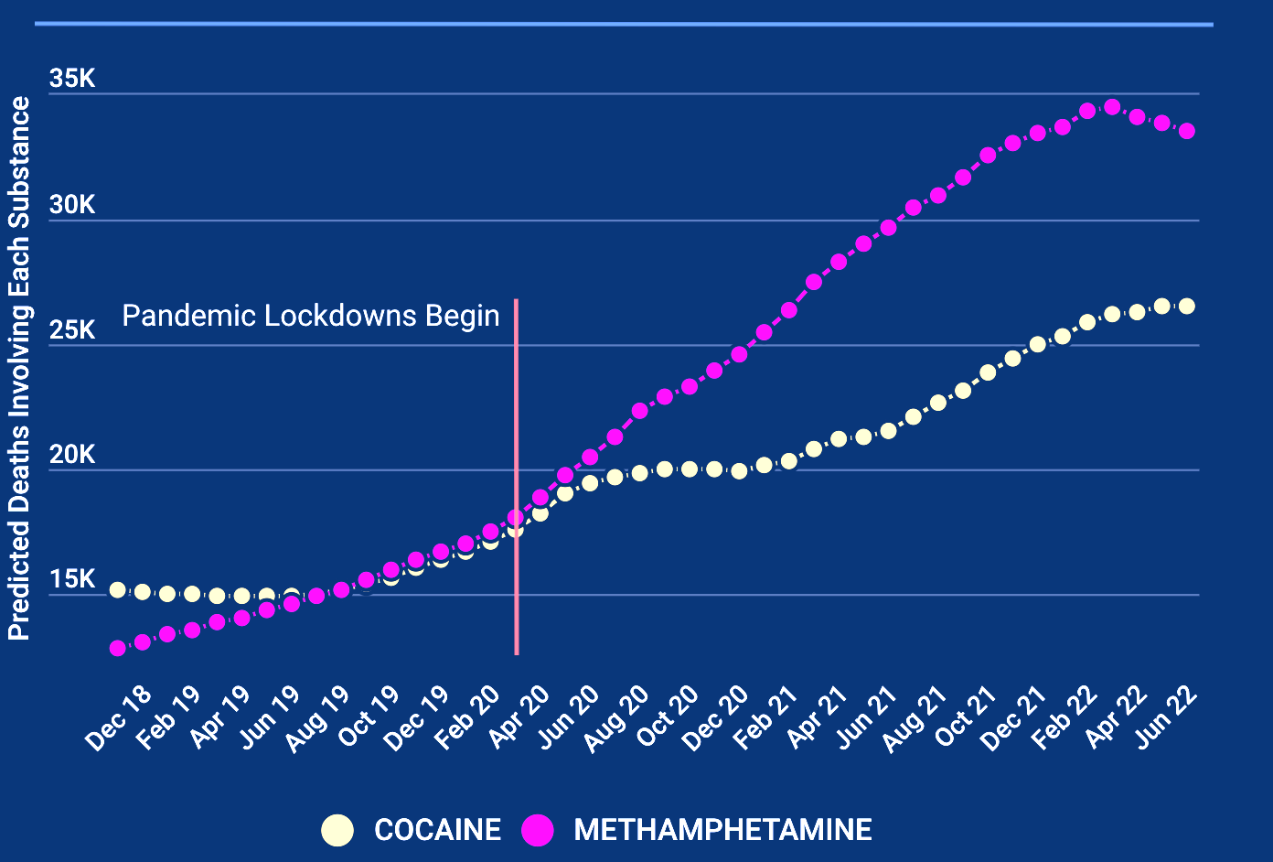
Background
Prescription stimulant misuse is a growing public health issue, especially among young adults. It also leads to high potential for addiction and severe health risks.
Stimulant medications: commonly prescribed for attention-deficit/hyperactivity disorder (ADHD).
Misuse stimulant: heart problems, seizures, panic attacks, paranoia, and even violent behavior.
Wong et al. Prevalence and Correlates of Prescription Stimulant Misuse Among US College Students: Results From a National Survey, 2022. (by NIH)
Notes:
The misuse of stimulant prescription medications, particularly among young adults, poses a significant public health concern. These medications, often used for conditions like ADHD, carry a high potential for abuse and dependency, as classified by the DEA as Schedule II substances. Misuse, defined as using the medication without a prescription or in ways not prescribed, can lead to severe health issues, such as cardiovascular events, addiction, and mental health problems. Additionally, misuse may contribute to the use of other illicit substances. Identifying patterns and factors associated with misuse is crucial for developing effective prevention strategies and reducing the associated health and social risks.

Slide 6
Background
A crucial step in developing effective prevention strategies is
identifying the tendencies and patterns associated with medication misuse
https://nihcm.org/publications/stimulant-drug-overdose-deaths-2022-update

Slide 7



Broad Impacts
Societal Impact:
Less legal issues, data driven insights for policy making
Public Health:
Better prevention, less system strain.
Individual Level:
Fewer health, dependency, and legal issues

Slide 8
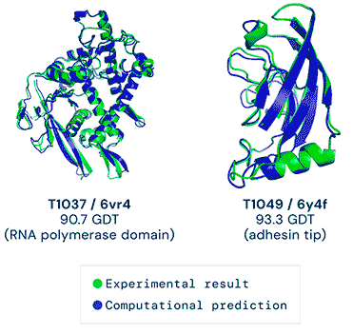
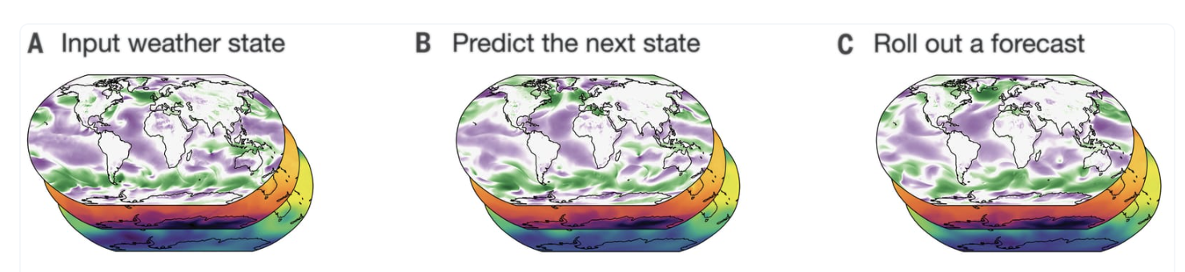
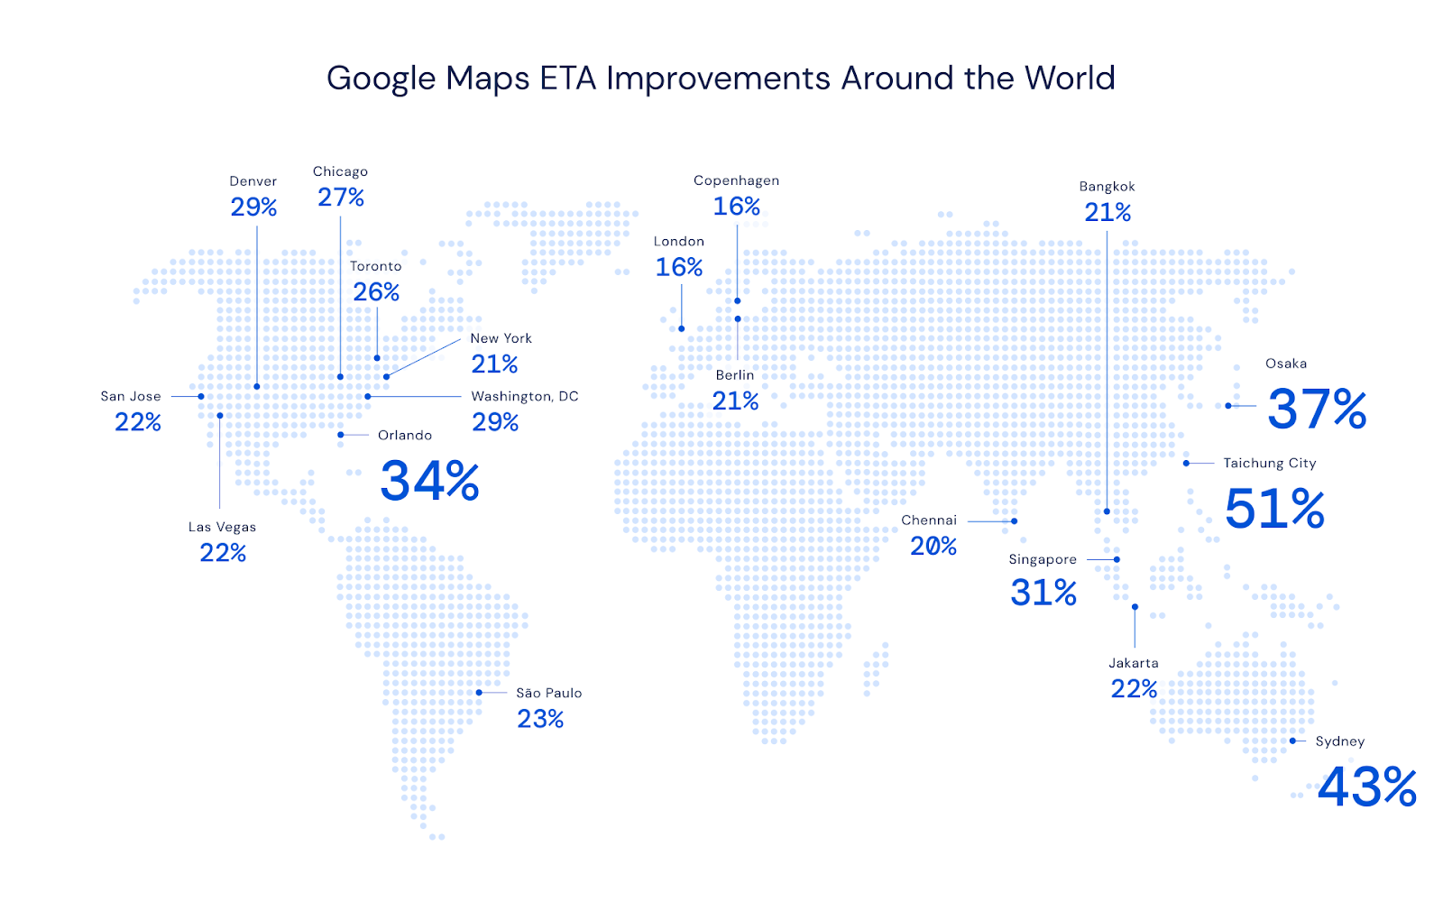


Graph Representation Learning: Broad Applications
AlphaFold (2020)
GraphCast (2023)
10-day forecasts in less than a minute on a single Google TPU
Google Map Traffic prediction (2020)
Mathematical theory (2021)
50% improved using GNNs
ETA: expected time of arrival
Notes:
Recently, graph representation learning techniques achieved great success across different domains, for example……
Deepmind company has made several breakthroughs using graph modeling methods, for protein structure prediction, weather forecasting, traffic flow prediction, and mathematical theory proof.

Slide 9
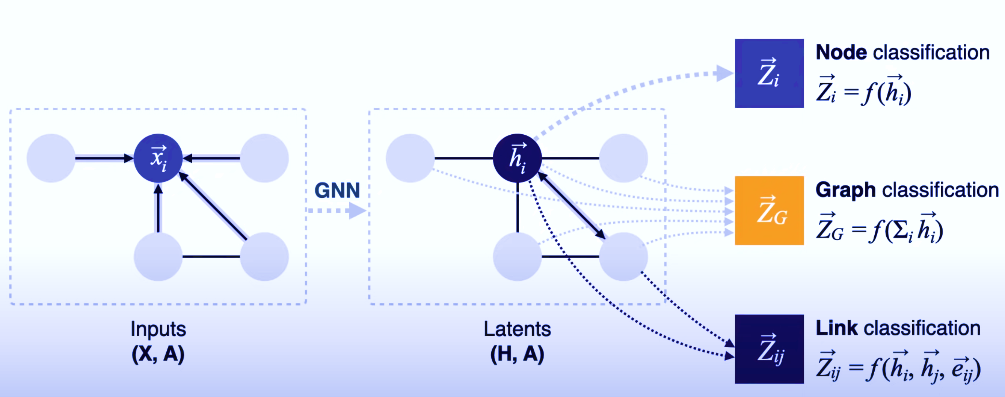
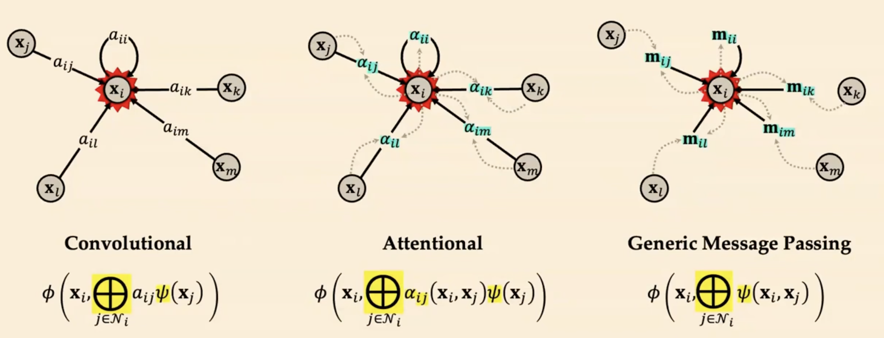
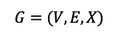
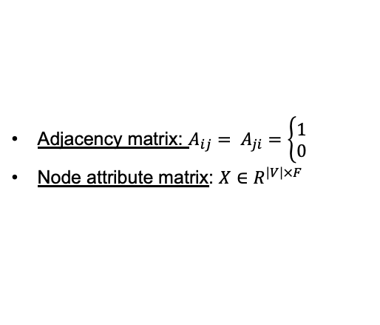
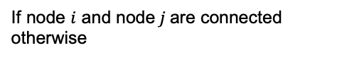
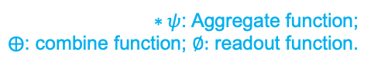
Emerging Graph Representation Learning Techniques
Goal: Encode non-Euclidean space irregular graph data into latent vector representations for diverse learning tasks.
Variants of GNNs: MPNN (Gilmer et al.2017), GCN (Kipf&Welling, 2017), GAT (Veliˇckovi´cetal., 2018), WL-GNN (2019), Graph transformers (2021), …, Graph-Mamba (2024)…
Downstream tasks
Node set
Edge set
Node representation learning
Stacked GNN layers
GCNs: apply the convolution kernel to effectively update node’s embedding by aggregating and transforming the information from its neighbors.
Notes:
The main goal of GNNs is to encode ….
Prevalent main types of GNNs include message passing neural networks (MPNNs),
Graph convolutional networks ; graph attention networks, graph transformers, and a recent work on graph mamba..
Below figure shows a input graph with node set V and edge set E, adjacency matrix A and node feature matrix X, it was input to GNN model including a number of layers, in the hidden space, each node feature can be updated by using a convolutional operation, see the right figure.
Each node embedding can be effectively updated by aggregating and transforming the information from its neighbors.
After L –layer GNNs, the node can be updated to a vector representation (h), and the graph structure information can be preserved. The node embeddings can be optimized with diverse downstream tasks (node classification, link prediction, and graph classification) using either L1 loss or L2 loss.
Using a GCN is ideal because it captures complex relationships between individuals (nodes) and their shared influences (edges), effectively leveraging interconnected survey data for more accurate predictions.

Slide 10
Outline
Background and Motivation
Methodology
Predicting stimulant misuse based on classic ML models
Predicting stimulant misuse based on advanced GCNs
Interpretability investigation by GNN Explainer
Experimental results and analysis
Conclusions
Acknowledgement
Notes:
Compared the results of the graph-based model GCN vs 6 other ML models
Use data from the National Survey on Drug Use and Health (NSDUH)
It is the primary source of statistics on the use of alcohol, tobacco, prescription psychotherapeutic medicines (such as sedatives, painkillers, tranquilizers, and stimulants), and other substances (such as cocaine and marijuana) by individuals in that population who are 12 years of age or older
GCN outperformed other models

Slide 11
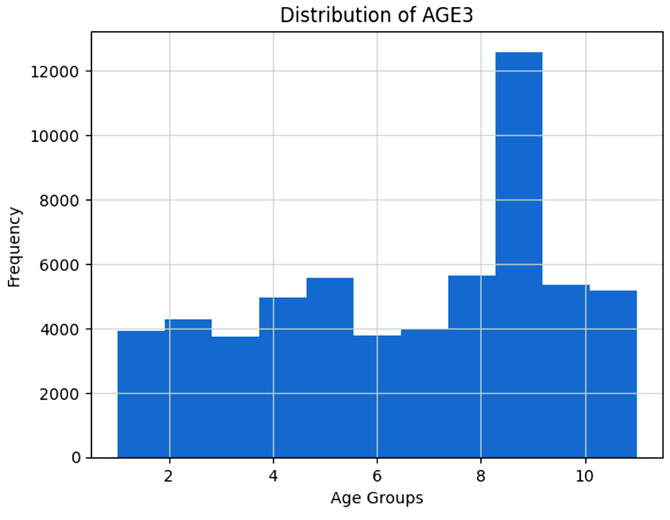
The NSDUH (2022) Dataset
Dimension (5000 individuals, 2606 features)
Number of Features (5000, 204 selected features)
Train/Test Split (80/20 split)
Cross Validation (3,5,10)
2 Classes, Yes/No
Notes:
59069 individuals over the age of 12
Mostly Respondent is between 35 and 49 years old which is category 9 of the survey question age
splited the dataset into training and testing subsets, with 80% of the data used for training the model and 20% reserved for evaluating its performance. The random_state=3 ensures the split is reproducible, providing consistent results across multiple runs.
Used the cross validation on models, Cross-validation splits the data into k folds (e.g., 3, 5, or 10) to train the model on k−1 folds and validate it on the remaining fold, rotating through all folds. This ensures the model is evaluated on different subsets of data, providing a robust measure of performance and reducing the risk of overfitting. Using 3-, 5-, or 10-folds balances computational cost and model evaluation accuracy, depending on the dataset size and complexity.
Two classes/labels as yes or no basically a binary classification

Slide 12
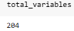
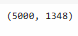
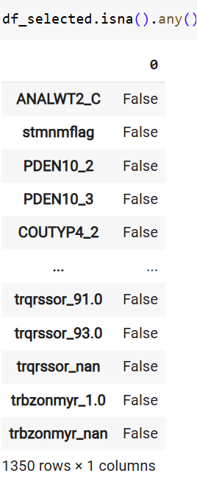
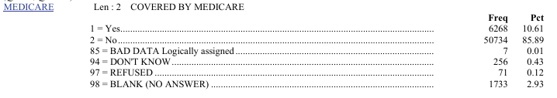
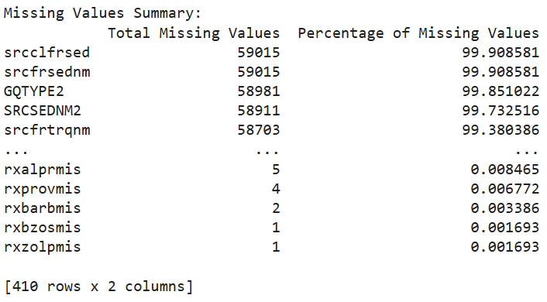
Data Preprocessing
Handling missing values.
Encoding categorical features.
Normalizing numerical data.
Notes:
Although there were considerable number of missing values in the entire dataset, there is no NaN in our selected features
Models like logistic regression, support vector machines (SVMs), and neural networks operate on numerical arrays. Categorical data needs to be converted into a format that preserves its meaning numerically.
One-hot encoding transforms categorical variables into binary columns (0s and 1s), where each unique category in a feature gets its own column. If a category is present in a row, its corresponding column is marked as 1, and all others are 0.
The cumulative expansion across all categorical features significantly increased the total number of variables, resulting in 1,350 variables.
used MinMaxScaler to normalize my data by scaling all numerical features to a range between 0 and 1. This ensured that all features contributed proportionally to the model and prevented larger values from dominating the learning process.

Slide 13
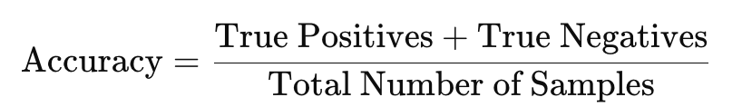
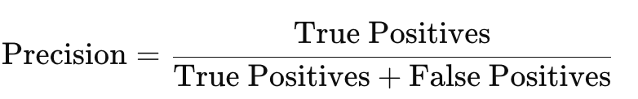
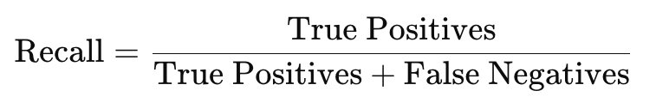
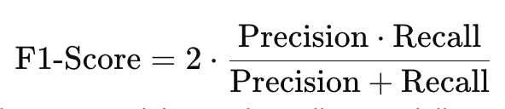
Performance Metrics
-----measure the proportion of correctly classified instances out of the total samples.
----- indicate how many of the predicted positive cases are actually positive
----- measure how many of the actual positive cases are captured by the model.
----- balance precision and recall,
especially useful for imbalanced datasets.
Notes:
Accuracy: The ratio of correctly predicted instances (true positives + true negatives) to the total instances.
Precision: The proportion of true positives among all predicted positives (true positives / (true positives + false positives)).
Recall (Sensitivity): The proportion of true positives identified out of all actual positives (true positives / (true positives + false negatives)).
F1-Score: The harmonic mean of precision and recall, balancing the trade-off between them.

Slide 14
M1: Logistic Regression
Binary Classification with Sigmoid Function
Hyperparameters (max_iter=200, solver = lbfgs, regularization c=1.0)
Balanced precision and recall, with an F1 score indicating high reliability
Strong performance for generalization
Metric | Test-Set (No CV) | 3-Fold CV | 5-Fold CV | 10-Fold CV
Accuracy | 0.9587 | 0.9602 ± 0.0025 | 0.9607 ± 0.0028 | 0.9604 ± 0.0031
Precision | 0.9512 | 0.9531 ± 0.0036 | 0.9537 ± 0.0038 | 0.9533 ± 0.0043
Recall | 0.9587 | 0.9602 ± 0.0025 | 0.9607 ± 0.0028 | 0.9604 ± 0.0031
F1 Score | 0.9549 | 0.9541 ± 0.0024 | 0.9546 ± 0.0032 | 0.9544 ± 0.0037
Notes:
Predicts binary outcomes using a logistic (sigmoid) function.Features linear interpretability and uses Maximum Likelihood Estimation for optimization.
Performance: Test Accuracy: 95.87%
Balanced precision and recall, with an F1 score indicating high reliability.
Insights: Strong performance for generalization.
High interpretability makes it ideal for understanding the influence of predictors.
max_iter=200: Sets the maximum number of iterations for the optimization algorithm to converge.
random_state=1: Ensures reproducibility by controlling the random seed for data shuffling and initialization.
Solver (solver='lbfgs'): Optimization algorithm used for finding the best model parameters (default is 'lbfgs', effective for small datasets).
Regularization (C=1.0): Controls the trade-off between fitting the training data and simplicity of the model (default strength).
Multi-class (multi_class='auto'): Automatically selects 'ovr' for binary problems or 'multinomial' for multi-class problems based on the dataset.
Cross-validation folds (3, 5, 10): Splits the data into 3, 5, or 10 subsets for model evaluation, cycling one subset as validation.
Regularization Parameter: Controls the trade-off between achieving a low error on the training set and minimizing model complexity to improve generalization.
Smaller Values (e.g., C < 1):
Stronger regularization is applied.
The model allows more margin violations (misclassified training samples) to prevent overfitting.
Useful when the dataset is noisy or has overlapping classes.
Larger Values (e.g., C > 1):
Weaker regularization is applied.
The model prioritizes correctly classifying all training points over having a larger margin.
Risk of overfitting, especially on noisy datasets.
Default Value (C=1.0):
Balances between regularization and correct classification of training data.
Suitable as a starting point for most applications.

Slide 15
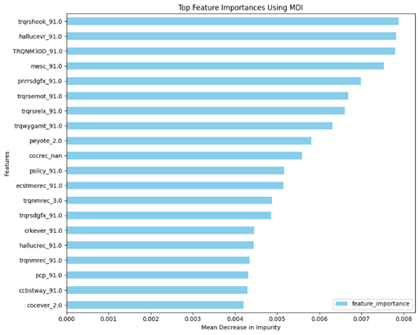
M2: Random Forest
Hyperparameters ('max_depth': 16, 'min_samples_split': 3, 'n_estimators': 200)
Feature importance revealed behavioral and demographic predictors as key.
Strong performance for generalization.
Metric | Test-Set (No CV) | 3-Fold CV | 5-Fold CV | 10-Fold CV
Accuracy | 0.9571 | 0.9591 ± 0.0013 | 0.9592 ± 0.0019 | 0.9592 ± 0.0024
Precision | 0.9485 | 0.9508 ± 0.0022 | 0.9508 ± 0.0027 | 0.9510 ± 0.0038
Recall | 0.9571 | 0.9591 ± 0.0013 | 0.9592 ± 0.0019 | 0.9592 ± 0.0024
F1-Score | 0.9487 | 0.9511 ± 0.0010 | 0.9513 ± 0.0023 | 0.9515 ± 0.0030
Notes:
Despite its overall strength, the model may encounter difficulties in accurately predicting instances of stimulant misuse, potentially due to limitations in feature selection or unreported cases in the dataset. For example, although both accuracy and recall are high, precision indicates that there is still potential for improvement in recognizing true positive cases.
Usging GridSearch:
Best Parameters: {'max_depth': 16, 'min_samples_split': 3, 'n_estimators': 200}
max_depth16 Maximum depth of each decision tree to prevent overfitting.
min_samples_split3 Minimum samples required to split a node, controlling tree growth.
n_estimators200Number of decision trees in the forest.random_state1Ensures reproducibility of the results.

Slide 16
M3: Gaussian Naïve Bayes
Hyperparameters (priors=None, var_smoothing=1e-9)
High precision and recall ensure balanced predictions
Strong performance for generalization
Quick to train, simple
Reliable for computational efficiency
Metric | Test-Set (No CV) | 3-Fold CV | 5-Fold CV | 10-Fold CV
Accuracy | 0.9080 | 0.9079 ± 0.0019 | 0.9079 ± 0.0020 | 0.9079 ± 0.0023
Precision | 0.9523 | 0.9522 ± 0.0009 | 0.9523 ± 0.0016 | 0.9523 ± 0.0019
Recall | 0.9080 | 0.9079 ± 0.0019 | 0.9079 ± 0.0020 | 0.9079 ± 0.0023
F1 Score | 0.9250 | 0.9250 ± 0.0015 | 0.9250 ± 0.0014 | 0.9250 ± 0.0017
Notes:
Probabilistic classifier based on Bayes' theorem with Gaussian distribution assumption.
Assumes conditional independence of features within each class.
priors=None:
The model does not assume any prior probabilities for classes (defaults to being learned from the data).
var_smoothing=1e-9:
A small value added to the variance for numerical stability, preventing division by zero during computations.

Slide 17
M4: K-Nearest Neighbors
Hyperparameters (n_neighbors=5, weights='uniform', algorithm='auto', leaf_size=30, metric='minkowski', p=2, n_jobs=None)
Euclidean distance metric with k=5
High recall but lower precision indicates false positives.
Balanced precision and recall increasing reliability
Metric | Test-Set (No CV) | 3-Fold CV | 5-Fold CV | 10-Fold CV
Accuracy | 0.9200 | 0.9550 ± 0.0170 | 0.9512 ± 0.0214 | 0.9525 ± 0.0278
Precision | 0.8843 | 0.9541 ± 0.0164 | 0.9323 ± 0.0508 | 0.9299 ± 0.0595
Recall | 0.9200 | 0.9550 ± 0.0170 | 0.9512 ± 0.0214 | 0.9525 ± 0.0278
F1 | 0.8946 | 0.9429 ± 0.0297 | 0.9390 ± 0.0350 | 0.9377 ± 0.0430
Notes:
k-NN algorithm showcases impressive predictive capability for stimulant misuse, particularly regarding its accuracy and recall scores. However, the discrepancies seen in precision and F1 scores imply that further enhancements, such as fine-tuning the k value, tackling possible class imbalances, or engaging in feature engineering, could bolster the overall robustness of the model.
n_neighbors=5:
The number of nearest neighbors to consider when making a prediction (k=5).
weights='uniform' (default):
All neighbors have equal influence on the prediction. You can set it to 'distance' to weigh neighbors by their distance.
algorithm='auto' (default):
Automatically chooses the best algorithm (ball_tree, kd_tree, or brute) based on the input data.
leaf_size=30 (default):
The size of leaf nodes in the tree structure; impacts speed and memory usage.
metric='minkowski' (default):
Distance metric for finding neighbors (Euclidean distance by default with p=2).
p=2 (default):
Parameter for the Minkowski metric; p=2 corresponds to the Euclidean distance.
n_jobs=None (default):
Number of parallel jobs for computation; None means it uses a single core.

Slide 18
M5: Support Vector Classifier
Hyperparameters (kernel='linear', C=1.0)
Minimizes false positives
Robust CV results
Balanced precision and recall increases reliability
Metric | Test-Set (No CV) | 3-Fold CV | 5-Fold CV | 10-Fold CV
Accuracy | 0.9150 | 0.9475 ± 0.0030 | 0.9400 ± 0.0064 | 0.9437 ± 0.0170
Precision | 0.9441 | 0.9460 ± 0.0051 | 0.9415 ± 0.0051 | 0.9469 ± 0.0190
Recall | 0.9150 | 0.9475 ± 0.0030 | 0.9400 ± 0.0064 | 0.9437 ± 0.0170
F1 Score | 0.9284 | 0.9467 ± 0.0040 | 0.9407 ± 0.0054 | 0.9431 ± 0.0175
Notes:
SVM model shows outstanding performance across both the test set and the cross-validation folds. The high precision and recall indicate that the model effectively balances the minimization of false positives and false negatives, making it suitable for applications where this balance is vital. The consistency of the metrics across various cross-validation methods further underscores the model’s reliability and robustness.
kernel='linear':
Specifies the kernel type to be used in the algorithm. 'linear' means the model will use a linear decision boundary.
C=1.0:
Regularization parameter. Smaller values specify stronger regularization, while larger values reduce it.
random_state=42:
Ensures reproducibility by fixing the random seed for processes like data shuffling and splitting.
Regularization Parameter: Controls the trade-off between achieving a low error on the training set and minimizing model complexity to improve generalization.
Smaller Values (e.g., C < 1):
Stronger regularization is applied.
The model allows more margin violations (misclassified training samples) to prevent overfitting.
Useful when the dataset is noisy or has overlapping classes.
Larger Values (e.g., C > 1):
Weaker regularization is applied.
The model prioritizes correctly classifying all training points over having a larger margin.
Risk of overfitting, especially on noisy datasets.
Default Value (C=1.0):
Balances between regularization and correct classification of training data.
Suitable as a starting point for most applications.

Slide 19
M6: Multi Layer Perceptron (MLP)
Hyperparameters (hidden_layer_sizes=(100,), max_iter=500)
Captures complex patterns
Requires significant computational resources.
Metric | Test-Set (No CV) | 3-Fold CV | 5-Fold CV | 10-Fold CV
Accuracy | 0.9450 | 0.9540 ± 0.0013 | 0.9580 ± 0.0093 | 0.9580 ± 0.0125
Precision | 0.9233 | 0.9454 ± 0.0045 | 0.9543 ± 0.0128 | 0.9528 ± 0.0212
Recall | 0.9450 | 0.9540 ± 0.0013 | 0.9580 ± 0.0093 | 0.9580 ± 0.0125
F1 | 0.9307 | 0.9473 ± 0.0056 | 0.9514 ± 0.0139 | 0.9521 ± 0.0173
Notes:
MLP model demonstrates outstanding performance in predicting stimulant misuse, achieving high accuracy and recall in all assessments. For further enhancement, efforts could target increasing precision by minimizing false positives through feature engineering or hyperparameter optimization. The model's strong generalization on a limited dataset emphasizes its robustness, positioning it as a valuable tool for stimulant misuse prediction initiatives.
hidden_layer_sizes=(100,):
Defines the architecture of the hidden layers in the neural network.
(100,) means there is one hidden layer with 100 neurons.
This structure is suitable for moderately complex datasets. You can specify more layers or neurons, e.g., (100, 50, 30) for a network with three layers of 100, 50, and 30 neurons, respectively.
max_iter=500:
Sets the maximum number of iterations (epochs) the optimizer will run to minimize the loss function.
Ensures the model stops training after 500 iterations, even if convergence is not achieved.
A higher value may improve convergence but increases computation time.
random_state=1:
Controls the randomness for initializing the weights of the neural network and shuffling the training data.
Ensures reproducibility of results, meaning you get the same output every time the model is trained with the same data and parameters.

Slide 20
M7: Predicting stimulant misuse based on advanced GCNs
Graph construction with KNNs
Data Preparation for the GCN
GCN Model Architecture
Model Training & Evaluation
GNN Explainer

Slide 21
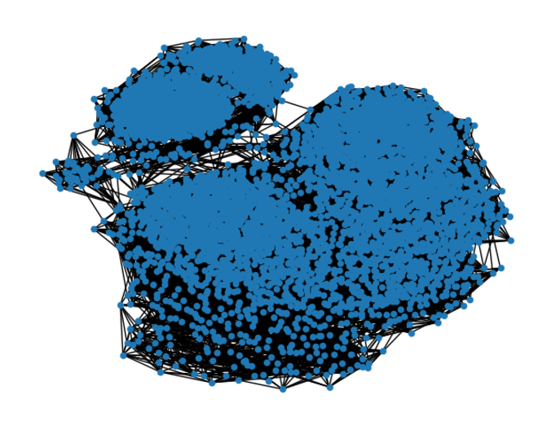
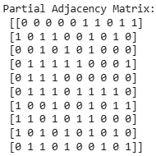
Step1: Build Graph for GCN
Create Adjacency Matrix 5000x5000 (Numpy array)
Convert to Graph (Networkx format)
Prepare for PyTorch Geometric
Handle Undirected Graphs
Notes:
Create Adjacency Matrix:
The adjacency matrix A represents these connections, where non-zero entries denote the distances between connected nodes.
A weighted K-Nearest Neighbors (KNN) graph is generated using kneighbors_graph, with k=11 to connect each node to its 11 nearest neighbors based on distance. The dimension fo our adjacny matrix is (5000, 5000) and it is symmetric.
Convert to Graph:
The sparse adjacency matrix is converted to a NetworkX graph G, making it easier to inspect edges and their weights to allow easier visualization and manipulatin
Prepare for PyTorch Geometric:
The NetworkX graph is converted into a PyTorch Geometric Data object.
Edge weights (representing distances) are assigned to the data.edge_weight attribute for use in weighted graph operations.
PyTorch Geometric represents graphs in a tensor format that can be processed efficiently on GPUs. This is essential for training GNNs
Handle Undirected Graphs:
Since the graph is undirected, edge weights are duplicated to match the bidirectional representation of edge_index in PyTorch Geometric.
If A is symmetric, is undirected.
For undirected graphs, each edge is counted twice
c. Adjusting for Symmetry:
To compute the number of edges in an undirected graph: Number of edges=Non-Zero Entries in A/2
If A has 87,822 non-zero entries, then:
87,8222/2 = 43,911

Slide 22
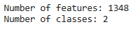
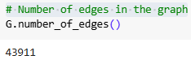
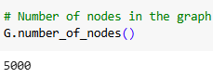
Step 2: Data Preparation for the GCN
Feature and label Conversion
Transductive model
Train-Test data split (80% Training, 20% Test)
Graph data integration (5000, 1348)
Notes:
Feature and Label Conversion:
The node features (X_less_rows) and labels (y_less_rows) are converted into PyTorch tensors to work with Pytorch
Features use FloatTensor, and labels use LongTensor for compatibility with the GCN.
2. Transductive GCN: The train-test split in a transductive setting is done at the node level, meaning all nodes and edges are part of the graph during training, but only specific nodes (test nodes) are used for evaluation. The model learns using the full graph structure. In transductive learning, the model has access to the entire graph, including nodes that are part of the test set, although it doesn't use their labels during training
2. Inductive GCN: In an inductive setting, the train-test split is done at the graph level, so the test nodes (or subgraphs) are entirely unseen during training. The model generalizes to unseen graphs or nodes.
2. Comparison: Transductive models exploit the global graph structure for all nodes, whereas inductive models generalize to new graph data without having prior access, making them more versatile for unseen scenarios.
3. Train-Test Split:
The data is split into training and testing sets using train_test_split with an 80/20 ratio.
4. Graph Data Integration:
The feature matrix (data.x), labels (data.y), and edge weights (data.edge_weight) are all stored in the PyTorch Geometric Data object.

Slide 23
Step 3: GCN Model Architecture
Input
Layers:
First Convolution Layer
ReLU Activation
Dropout
Second Convolution Layer
SoftMax
Output
Notes:
First Convolution Layer (GCNConv):
Applies graph convolutions to extract node-level features while considering graph structure.
ReLU Activation (F.relu):
Introduces non-linearity after the first convolution to enhance feature learning.
Dropout (F.dropout):
Prevents overfitting by randomly dropping 50% of neurons during training.
Second Convolution Layer (GCNConv):
Produces final node embeddings and output logits for classification.
Softmax (F.log_softmax):
Converts logits to probabilities.
Training Loop:
Runs for 1000 epochs, minimizing the cross-entropy loss and updating weights using the Adam optimizer.

Slide 24
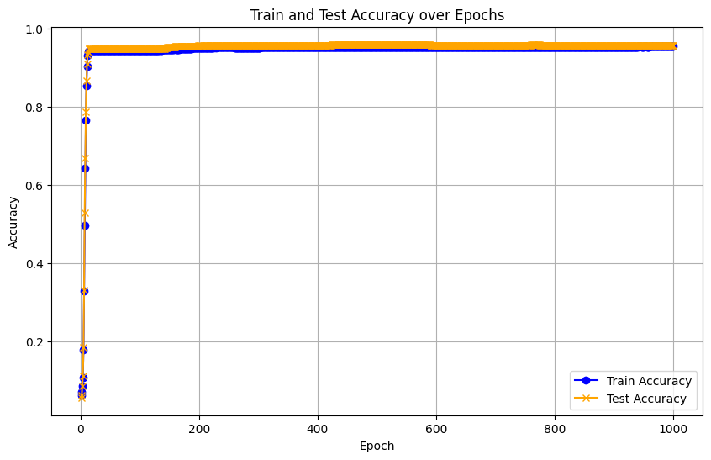
Model Training & Evaluation
Hyperparameter settings:
Learning rate: 0.0001
Batch size: Full batch training
Optimizer: Adam
Epochs: 1000
Loss Function: CrossEntropy
Notes:
The GCN model achieved strong generalization, with training accuracy of 95.47% and test accuracy of 96.10%, indicating reliable predictions without overfitting. The narrow accuracy margin between training and testing and the early performance plateau suggest optimal convergence and potential for early stopping.
Learning rate: 0.0001
Batch size: Full batch training
Defines how much data the model processes before updating weights. In this case, "full batch training" means using the entire dataset in one update, a hyperparameter set externally.
Optimizer: Adam
The choice of the optimization algorithm (Adam) is a hyperparameter because it is set before training and impacts how the model converges.
Epochs: 1000
Specifies the number of complete passes through the entire dataset during training, a pre-determined hyperparameter.
LOSS Function: The model uses a cross-entropy loss function to minimize classification errors.
Train and test loss not following exact patterns
Add l2 regularization to penalize large weights
Increase dropout to reduce overfitting
Adjusting learning rate
Modify architecture to increase number of hidden layers
Why my train and test loss do not follow same pattern?
Imbalanced Data: Unequal class distribution can skew the test performance. You can use SMOTE for oversampling or undersampling
Learning Rate Issues: An inappropriate learning rate may cause unstable updates, leading to diverging loss patterns.

Slide 25
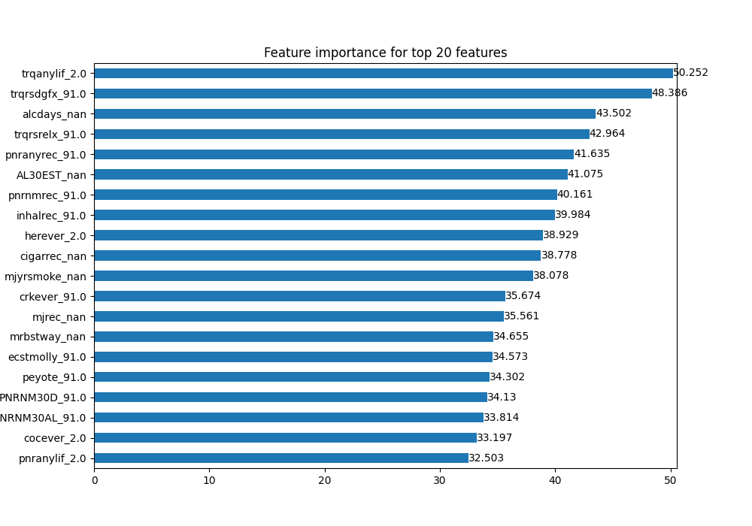
GNN Explainer – Feature Importance
Feature | Description | Importance Score
trqanylif | Ever used any prescription tranquilizer | 50.252
alcdays | Main reason for using tranquilizers | 48.386
alcdays | The number of days alcohol consumed in the past 30 days. | 43.502
trqrsrelx | Tranquilizers were used to relax or relieve tension. | 42.964
pnranyrec | When for most recent pain reliever used. | 41.635
AL30EST | The number of days had one or more drinks. | 41.075
pnrnrec | Recent nonmedical use of pain relievers. | 40.161
inhalrec | Whether inhalants were recently used. | 39.984
herever | If heroin has ever been used. | 38.929
cigarrec | Time since last smoked Cigar. | 38.778
mjyrsmoke | Did you smoke marijuana within last year. | 38.078
crkever | Ever used crack. | 35.674
mjrec | When last smoked marijuana. | 35.561
mrbstway | Most recent method marijuana was used. | 34.655
ecstmolly | Ever used MDMA/ecstasy | 34.573
peyote | Ever used peyote (is a hallucinogen) | 34.302
PNRNM30D | Pain reliever nonmedical use in the past 30 days | 34.130
NRNM30AL | Nonmedical alcohol use in the past 30 days. | 33.814
cocever | Indicates if cocaine was ever used. | 33.197
pnranylif | Indicates lifetime use of pain relievers. | 32.503
https://arxiv.org/abs/1903.03894
Notes:
Feature importance analysis identified significant predictors like "trqanylif" (tranquilizer usage) and "trqrsgdfx" (reason for usage), highlighting the relevance of behavioral and demographic factors in predicting misuse. The study demonstrates the practical implications of machine learning in public health by showing how graph-based approaches like GCN can provide actionable insights into individual risk factors, enabling targeted interventions.

Slide 26
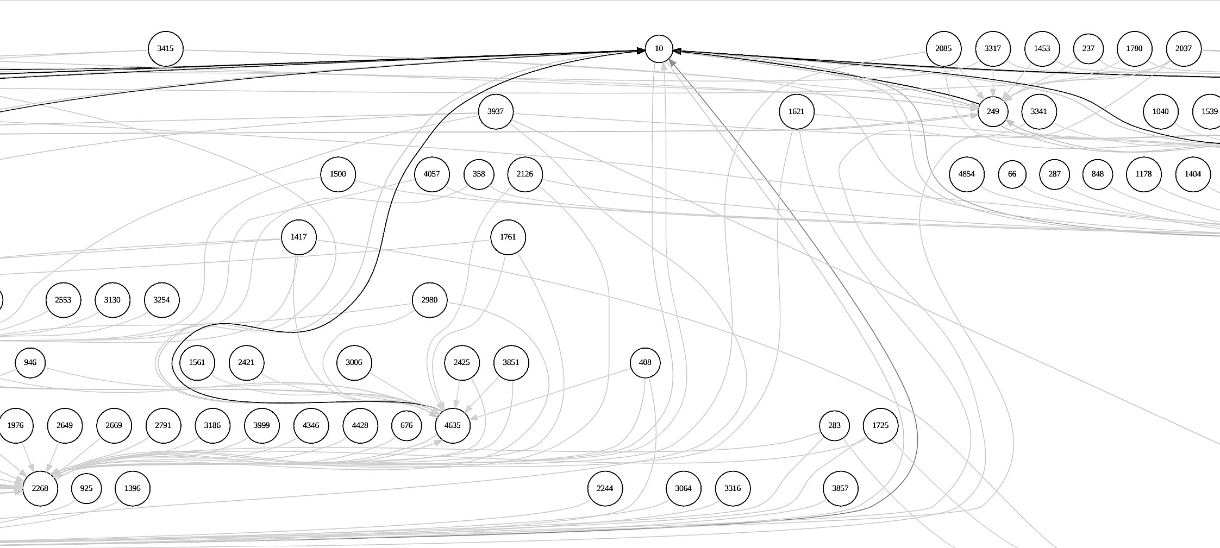
GNN Explainer - Subgraph Visualization
https://colab.research.google.com/drive/1RkUiL_9Az7lJLYHoU4YI-chssvAu5IS9#scrollTo=NCtkdtWYEYIx
Notes:
Especially useful for personalized risk assessments and targeted interventions.
The subgraph visualization, generated by the GNNExplainer for node_index = 10, highlights the most influential nodes and edges impacting the model's prediction for this specific node. It simplifies the larger graph, emphasizing only the critical relationships and features that contribute significantly to the prediction, with edge importance determined by calculated scores. In the context of predicting stimulant misuse, the subgraph reveals key factors such as social connections, demographic traits, or behavioral patterns that influence risk evaluation.

Slide 27
Conclusion
The developed GCN model achieved a test accuracy of 96.1%, outperforming several baseline models, including Logistic Regression, Random Forest, MLP, KNNs, SVM, and Gaussian Naive Bayes.
High predictability
Interpretable results with feature importance
Rank | Model | Accuracy
1 | GCNs | 0.9610
2 | Logistic Regression | 0.9587
3 | Random Forest | 0.9571
4 | MLP | 0.9450
5 | KNN | 0.9200
6 | SVM | 0.9150
7 | Gaussian NB | 0.9080
Notes:
GCN's Superior Performance: The GCN achieved the highest test accuracy (96.10%) and training accuracy (95.47%), showcasing its ability to model complex relationships in graph-structured data, making it ideal for predicting stimulant misuse.
By modeling individuals as nodes and their relationships as edges, GCNs effectively capture complex interdependencies and relational patterns within the dataset,
This demonstrates GCN’s ability to uncover connections that traditional models might miss, making it well-suited for tasks where contextual and relational factors are critical.
Conventional models like Random Forest and Logistic Regression also performed reliably, with test accuracies of 95.71% and 95.87%, respectively, while simpler models such as Gaussian Naive Bayes and k-Nearest Neighbors achieved satisfactory results, albeit less competitive.

Slide 28
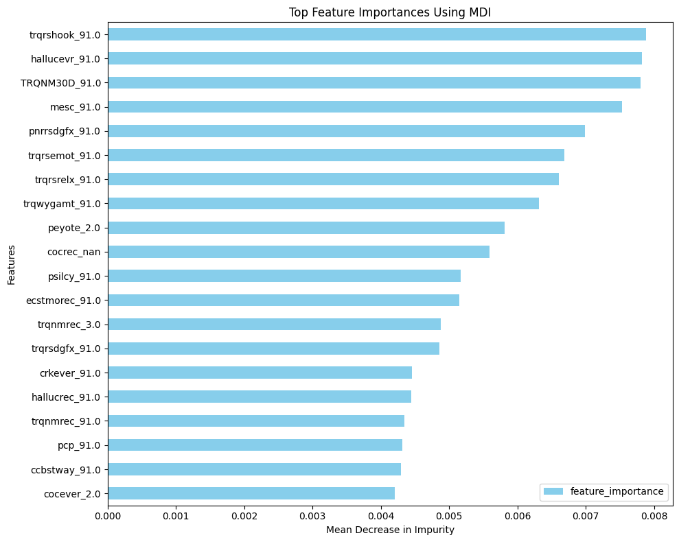
Potential Future Works
Improve Feature Selection
Medication Categories
Target-Specific Focus
Alternative Graph Construction
Regularization
Notes:
Better Feature Selection: Using heatmaps, you can identify highly correlated (redundant) or irrelevant features, reducing dimensionality and noise, which improves model efficiency and generalization. Feature importance highlights the most predictive features, allowing you to focus on key contributors for better performance and enhanced interpretability
Medication Categories: Adapt the GCN model to predict misuse for painkillers, sedatives, and tranquilizers by customizing features and graph structures.
Target-Specific Focus: Refine the model for specific drugs like Adderall by incorporating relevant factors in the graph.
Alternative Graph Construction: Explore methods like cosine similarity to improve edge and weight representation in the graph.
Feature Optimization: Analyze feature importance to reduce redundancy and add domain-specific features for better predictions.
Regularization: Implement techniques like dropout or L2 regularization to ensure robustness in complex datasets.
Hyperparameter Tuning: Optimize learning rates, GCN layers, and convolution methods to enhance predictive performance.
Why GCN and not GNN:
If your graph data were more heterogeneous, dynamic, or required attention mechanisms (e.g., varying edge weights based on importance), other GNNs like GATs or Graph Isomorphism Networks (GINs) might be more suitable. However, for static, homogenous graphs like in your research, GCNs strike an excellent balance between performance, scalability, and interpretability.

Slide 29
Acknowledgements
Advisor:
Dr. Mengjia Xu
Committee:
Dr. Hai Phan
Dr. Mengnan Du
Dr. Lijing Wang
Personal support:
Family, Sahar
Notes:
Will send thesis

Slide 30
Questions?
Thank you for your attention!

Slide 31
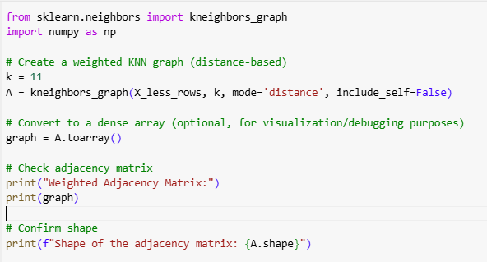
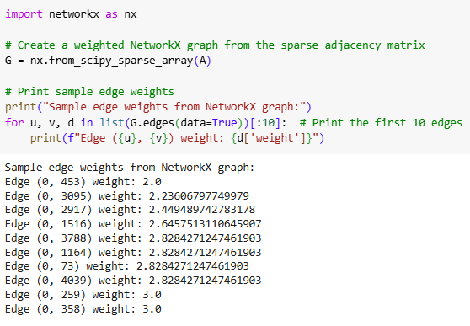
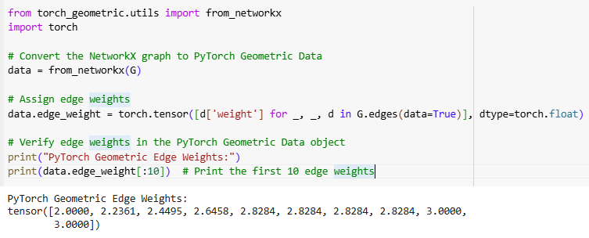
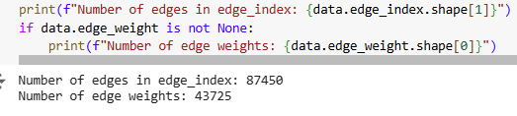
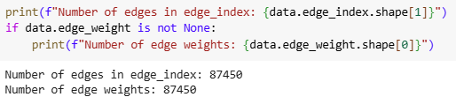
Building Graph
1. Create Adjacency Matrix (Numpy array)
2. Convert to Graph (Networkx format)
3. Prepare for PyTorch Geometric
4. Handle Undirected Graphs
Notes:
The adjacency matrix is called sparse when most of its elements are zero, which typically happens in large graphs with few connections compared to the total number of possible connections.
An adjacency matrix represents the connections between nodes in a graph:
Structure:
Rows and columns correspond to nodes.
Each element A[i, j] indicates the connection between node i and node j.
Weighted vs. Unweighted:
Weighted: because we have mode=distance
Diagonal Elements:
Typically 0 if self-loops are not allowed (no node connects to itself).
In a weighted graph, some edges have higher weights because the weights reflect the strength or significance of the connection between the nodes which means having more shared features.
Create Adjacency Matrix:
A weighted K-Nearest Neighbors (KNN) graph is generated using kneighbors_graph, with k=11 to connect each node to its 11 nearest neighbors based on distance.
The adjacency matrix A represents these connections, where non-zero entries denote the distances between connected nodes.
Convert to Graph:
The sparse adjacency matrix is converted to a NetworkX graph G, making it easier to inspect edges and their weights to allow easier visualization and manipulatin
Prepare for PyTorch Geometric:
The NetworkX graph is converted into a PyTorch Geometric Data object.
Edge weights (representing distances) are assigned to the data.edge_weight attribute for use in weighted graph operations.
PyTorch Geometric represents graphs in a tensor format that can be processed efficiently on GPUs. This is essential for training GNNs
Handle Undirected Graphs:
Since the graph is undirected, edge weights are duplicated to match the bidirectional representation of edge_index in PyTorch Geometric.

Slide 32
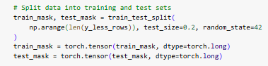
Step 2: Data Preparation for the GCN
Feature and label Conversion
Transuductive model
Train-Test data split (80% Training, 20% Test)
Graph data integration (5000, 1348)

Slide 33
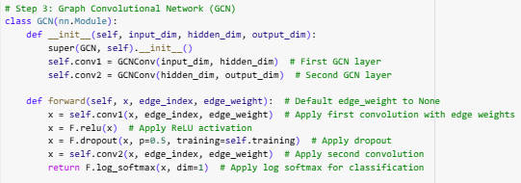
Step 3: GCN Model Architecture
Input
Layers:
First Convolution Layer
ReLU Activation
Dropout
Second Convolution Layer
SoftMax
Output
Notes:
__init__ Method:
The __init__ method initializes the model's components (layers).
class GCN(nn.Module):
Defines the GCN model as a subclass of PyTorch's nn.Module.
def __init__(self, input_dim, hidden_dim, output_dim):
The constructor method for initializing the model's structure, specifying input, hidden, and output dimensions.
super(GCN, self).__init__()
Calls the parent class (nn.Module) constructor to inherit its functionality.
self.conv1 = GCNConv(input_dim, hidden_dim)
Defines the first graph convolutional layer, which transforms input features (input_dim) to hidden features (hidden_dim).
self.conv2 = GCNConv(hidden_dim, output_dim)
Defines the second graph convolutional layer, which transforms hidden features (hidden_dim) to output features (output_dim).
forward Method:
The forward method defines the computation performed when data is passed through the model.
def forward(self, x, edge_index, edge_weight):
Defines the forward pass of the GCN, which processes node features (x) using graph structure (edge_index) and edge weights (edge_weight).
x = self.conv1(x, edge_index, edge_weight)
Applies the first GCN layer to update node features based on neighbors and edge weights.
x = F.relu(x)
Applies a ReLU activation function to introduce non-linearity into the model.
x = F.dropout(x, p=0.5, training=self.training)
Applies dropout with a probability of 50% to prevent overfitting during training.
x = self.conv2(x, edge_index, edge_weight)
Applies the second GCN layer to produce the final node embeddings or logits.
return F.log_softmax(x, dim=1)
Applies a log-softmax activation, converting logits into normalized probabilities for classification.
The hidden dimension refers to the number of neurons (units) in the hidden layer of a neural network or Graph Neural Network (GNN). It is a hyperparameter that controls the size of the intermediate feature representations learned by the model.

Slide 34
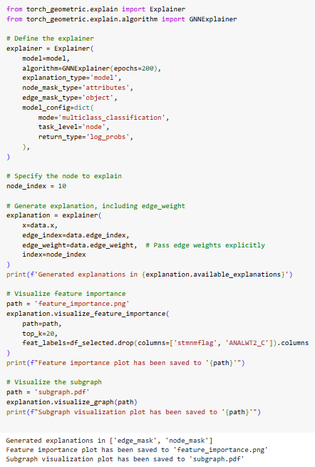
GNN Explainer - Subgraph Visualization
https://colab.research.google.com/drive/1RkUiL_9Az7lJLYHoU4YI-chssvAu5IS9#scrollTo=NCtkdtWYEYIx
Notes:
The subgraph visualization, generated by the GNNExplainer for node_index = 10, highlights the most influential nodes and edges impacting the model's prediction for this specific node. It simplifies the larger graph, emphasizing only the critical relationships and features that contribute significantly to the prediction, with edge importance determined by calculated scores. In the context of predicting stimulant misuse, the subgraph reveals key factors such as social connections, demographic traits, or behavioral patterns that influence risk evaluation. This approach provides actionable insights by showcasing the model's decision-making process in an interpretable format, making it especially useful for personalized risk assessments and targeted interventions.
model=model: Specifies the GNN model to explain.
algorithm=GNNExplainer(epochs=200): Uses GNNExplainer to train for 200 epochs to identify influential graph components.
explanation_type='model': Explains the model's overall behavior.
node_mask_type='attributes': Focuses on node attributes for explanations.
edge_mask_type='object': Focuses on edges as objects of explanation.
model_config: Specifies the task type
:mode='multiclass_classification': Indicates a multi-class classification task.
task_level='node': Explains predictions at the node level.
return_type='log_probs': Indicates that the model outputs log probabilities.
node_index = 10
Specifies the index of the node whose prediction you want to explain.
x: Node features.
edge_index: Graph connectivity.
edge_weight: Weights of the edges.
index=node_index: Specifies the node for which the explanation is generated.
Top_k=20
Generates a plot of the top 20 most important features

Slide 35
Model Training & Evaluation
Hyperparameter settings:
Learning rate: 0.0001
Batch size: Full batch training
Optimizer: Adam
Epochs: 1000
Loss Function: CrossEntropy
Notes:
Train and test loss not following exact patterns
Add l2 regularization to penalize large weights
Increase dropout to reduce overfitting
Adjusting learning rate
Modify architecture to increase number of hidden layers
Why my train and test loss do not follow same pattern?
Imbalanced Data: Unequal class distribution can skew the test performance. You can use SMOTE for oversampling or undersampling
Learning Rate Issues: An inappropriate learning rate may cause unstable updates, leading to diverging loss patterns.

